Slide 1
Lecture 9
SDN
OpenFlow

Slide 2
Software Defined Networking (SDN)
Software Defined Networking is a network framework which involves in separating a network's control function from its data forwarding functions, centralizing its intelligence and abstracting its underlying architecture from application and services.

Slide 3
Closed Innovation in Network Community
APP
Feature
OS
Hardware
APP
Feature
OS
APP
Feature
Hardware
OS
APP
Feature
Hardware
OS
Hardware
APP
Feature
OS
Hardware

Slide 4
Implementing the control functionalities and the data functionalities in a single router, increases the complexity of the control functionality
Multiple routers with their control planes and those control planes need to coordinate with each other to generate the global routing table, or to manage the global routing table.
Distance vector and the link state routing protocols have significant limitation in terms of their scalability
If there is a policy change then you need to update every individual router. And, all the routing protocols in all the routers control plane they need to get coordinated with each other to make an policy update at the individual routers, and obviously, in a distributed architecture it will take time
And you are deploying these routers not in a single day, you are expanding your network gradually and you do not know that what was the configuration of the earlier router

Slide 5
Then comes off the compatibility among the vendors, it is not like that all the routers of an organization they will come from Cisco, or even if they come from Cisco they will have the same model as you make a gradual deployment that other routers may come from different vendors
And with this distributed architecture, maintaining consistency across the configuration of the routers becomes difficult and that is why we gradually try to move from a distributed control plane architecture to a centralized control plane architecture
And, that is the basic motivation behind the design of a software defined networking concept

Slide 6
Control & Data Plane
Control Plane
The module which takes all decision , basically an instructor
The routing algorithm
Data Plane
The module which carries out the tasks given by the control plane
Forwarding of Packets

Slide 7




Traditional Network Devices are proprietary
Vendors decide software (control plane) and hardware (data plane)
No standardization
These two modules are "baked in" , Unchangeable

Slide 8
What does separating control and data plane means ?
Vendors only provide the hardware (data plane)
We decide the control plane by writing the custom logic (software / through control plane)
Advantages:
Features are no longer limited to what the vendors provides
Community Development
Long life of Products

Slide 9
How does SDN Work?
Compared to tradional networks , SDN has 2 types of devices
1. Controller (open flow , ryu , pox , nox , open daylight)
2. Switches
The Switches in SDN are blind
No built in features
Need to be instructed by Controller

Slide 10
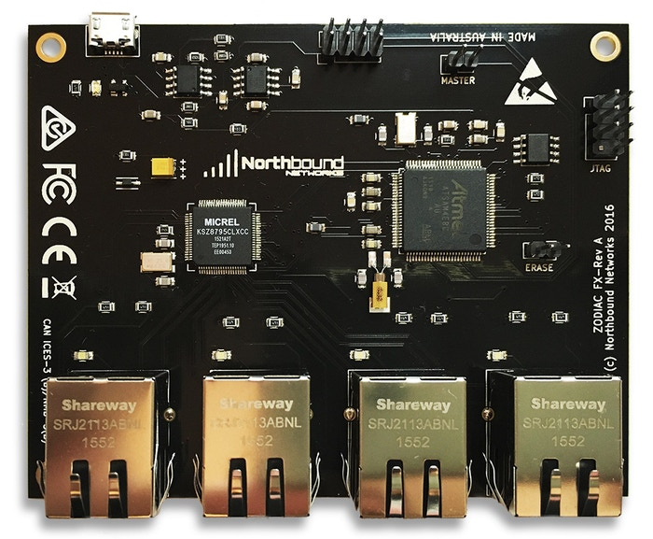
Zodiac FX: The world's smallest OpenFlow SDN switch
TCAM:
Ternary Content Addressable Memory it's used for faster address lookup that enables fast routing/switching.

Slide 11
SDN Controller
Brains of the Network
All Policies , routing logic are placed in the controller
Instruct the switches what to do with an unknown packet

Slide 12
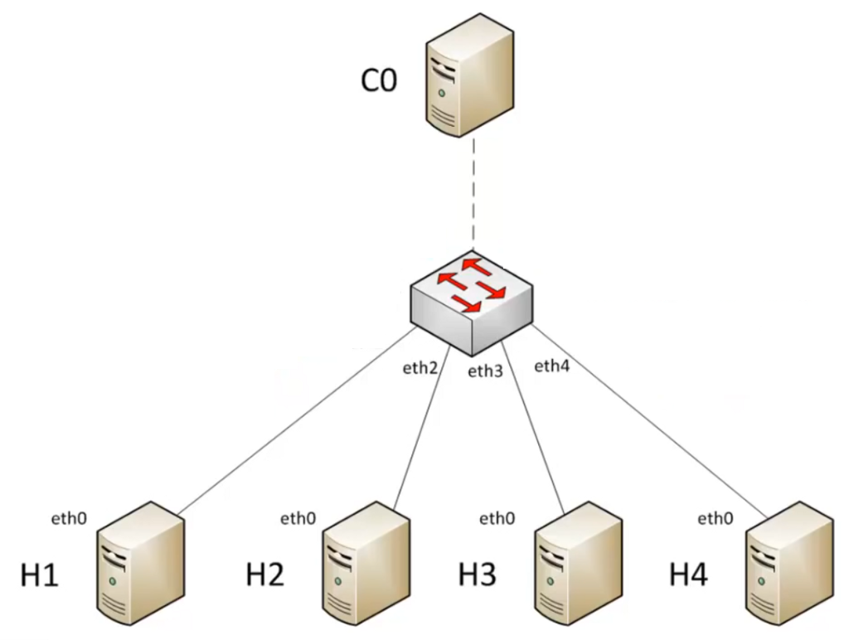
A scenario from h1 to h3 in SDN
Packet in
Pakett out
Table Miss ?
s1
Packet is buffered at Switch s1

Slide 13
So, you want to forward a packet from h1 to h3
the host forwards the packet to switch s1
Now whenever the packet comes to switch s1, initially this switch does not have any information
It just have a TCAM hardware, so it does not know how to forward the packet
So, what the switch does?
The switch sent an “packet in” event to the controller; that means, the switch informs the controller that I have received a packet.
With this packet in message, it sends the packet information the packet metadata to the controller.
And then the controller actually decides that what to do with that packet and return back the information to the switch in a “packet out” event.
And till that time the packet is buffered at s1, buffered at the switch.

Slide 14
Now, the controller sends to rule <match , action> to the switch then this rule is installed in that TCAM hardware of the switch.
So, relevant rule is generated by the controller. And it is installed in the TCAM hardware of the switch.
And for all the subsequent packet follow the same rule

Slide 15
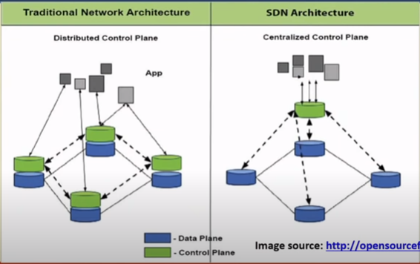
Traditional network architecture vs. SDN

Slide 16
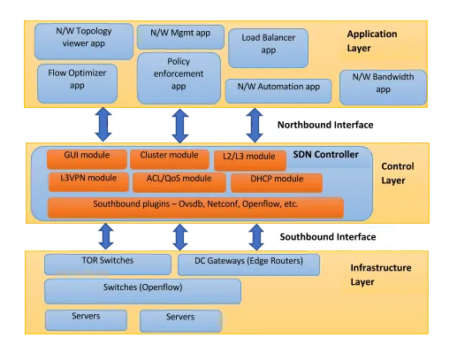
SDN Architecture

Slide 17
Summary
The network operating system and the corresponding infrastructure, we require an open interface to the hardware.
We do not depend on the corresponding vendors to program our network, we require a open interface to the hardware for that.
The second thing is that we require an open API for the application development so, that any application developer can develop a network application.
And the third thing is that, we require an extensible operating system to convert the programs to the rules.
So, these applications they are nothing but a program.
From that program, we need to map it to the corresponding rule, which will be executed at that TCAM hardware of the packet forwarding engine, which is inside the switches

Slide 18
What is Open Flow
OpenFlow (OF) is considered one of the first software-defined networking (SDN) standards
it originally defined the communication protocol in SDN architectures that enabled the SDN controller to directly interact with the forwarding plane of network devices such as switches and routers

Slide 19
Is OpenFlow SDN?
No. OpenFlow is an API that is standardized between control plane and data plane. OpenFlow is an enabling technology for SDN. SDN may build over other enabling technology.

Slide 20
OpenFlow has Two Components
OpenFlow Controller
Control one or more switches
Formulates Flows
Programs switches
Directives may come from external applications via REST API
OpenFlow Switch
OpenFlow agent (client) runs on switch to communicate with the controller
Processes commands from controller to populate the flow table

Slide 21
OpenFlow Controllers
Variety of Controllers:
NOX / P0X
Ryu
Floodlight
OpenDaylight
Pyretic
Frenetic
Procera
RouteFlow
Trema
Considerations :
Programming Language
Performance
User base and support
Focus :
Southbound API Northbound API
Production, Education, Research?

Slide 22
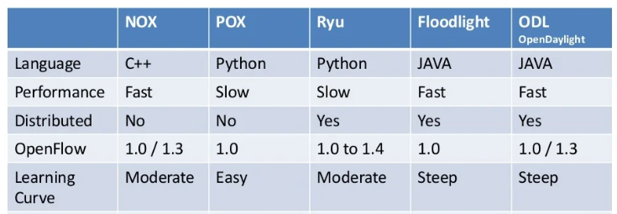
Controller Summary

Slide 23
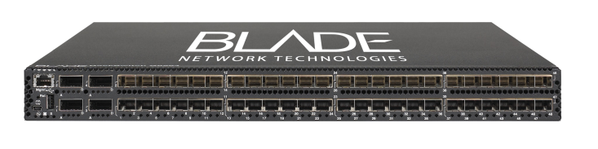

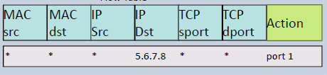

OpenFlow switch
OpenFlow controller
software
OpenFlow Client
hardware
Flow table
Port 1
Port 2
Port 3
Port 4

Slide 24
OpenFlow Flow Table Entries
Priority
Rule
Action
Stats
Packet + byte counters
Forward packet to zero or more ports
Encapsulate and forward to controller
Send to normal processing pipeline
Modify Fields
Any extensions you add!
Switch
Port
VLAN
ID
MAC
src
MAC
dst
Eth
type
IP
Src
IP
Dst
IP
ToS
IP
Prot
TCP
sport
TCP
dport

Slide 25
Examples
Switching
Switch
Port
MAC
src
MAC
dst
Eth
type
VLAN
ID
IP
Src
IP
Dst
IP
Prot
TCP
sport
TCP
dport
Action
*
*
00:1f:..
*
*
*
*
*
*
*
port6
Process to process Switching
Switch
Port
MAC
src
MAC
dst
Eth
type
VLAN
ID
IP
Src
IP
Dst
IP
Prot
TCP
sport
TCP
dport
Action
port3
00:20..
00:1f..
0800
vlan1
1.2.3.4
5.6.7.8
4
17264
80
port6
Firewall
Switch
Port
MAC
src
MAC
dst
Eth
type
VLAN
ID
IP
Src
IP
Dst
IP
Prot
TCP
sport
TCP
dport
Action
*
*
*
*
*
*
*
*
*
22
drop

Slide 26
Examples
Routing
Switch
Port
MAC
src
MAC
dst
Eth
type
VLAN
ID
IP
Src
IP
Dst
IP
Prot
TCP
sport
TCP
dport
Action
*
*
*
*
*
*
5.6.7.8
*
*
*
port6
VLAN Switching
Switch
Port
MAC
src
MAC
dst
Eth
type
VLAN
ID
IP
Src
IP
Dst
IP
Prot
TCP
sport
TCP
dport
Action
port6,
port7,
port9
*
*
00:1f..
*
vlan1
*
*
*
*
*

Slide 27
Open Flow Messages
Once TCP connection is made, OpenFlow Hello message is exchanged between the controller and the Switch
Negotiate OF version
Agree on highest version supported
Controller send OF Feature Request message
Determine what features switch supports
Based on application program , OpenFlow messages for switch configuration (flow entries) are sent

Slide 28
To check connection aliveness , echo request and echo reply messages are sent from either controller or switch
To group flow entries, groups are configured by the controller through group messages that can be stored into group tables inside switches
To get statistics details from switch , OpenFlow messages like flow stats , port stats can be sent from controller
Asynchronous messages are initiated by the switch and used to update the controller of network events and changes to the switch state.
Switches send asynchronous messages to the controller to denote a packet arrival, switch state change, or an error

Slide 29
Open Flow Protocol Overview
OpenFlow protocol supports three message types
Controller-to-switch - initiated by controller and may not require a response.
Asynchronous - switch sends to controller without controller requesting
Symmetric- sent by either controller or switch without being requested
Controller-to-switch
Feature Request
Configuration
Modify state- used to add / delete / modify flows on the switch
Asynchronous
Packet-in
Flow removed
Symmetric
Hello
Echo

Slide 30
Video related to Hypervisors
https://www.youtube.com/watch?v=yHT4kq36PE4

